Slide 1

AI Hospitality in Hotels
Casey Regetz and James Clinton

Slide 2
What Could Be Improved In Hotels?
Troubles with all customer’s requests
Constant maintenance
Messy Rooms
Broken Water/AC Units
Being able to accommodate customers of different languages.
Notes:
With hundreds to thousands of guests staying at a hotel at any given time, caring for each and every guest is hard and in some cases impossible without the staff to do so.
Maintenance takes a lot of time, and effort, and with dealing with the aforementioned customers coming in and out, it is hard to make sure everything is working and in pristine condition.
No one knows all languages, most people know 1 to 2 languages, and you never know who is walking through the door. It's a struggle to understand someone in a different language.

Slide 3
Marriott’s Vision
Marriott in Singapore plans to implement forward facing AI for customer interaction to act as a mediator between the customer and the hotel staff.
Features include:
Chatbot/Digital Concierges
Automatic Check-in/Check-out systems
Service Robots(Room Service, Providing Clean Amenities)
Notes:
Marriott in Singapore plans to implement forward facing AI for customer interaction to act as a mediator between the customer and the hotel staff.
Chatbot for customer support
Digital Concierges
Automatic Check-in/Check Out Systems so you don’t have to wait in line at the front desk to get your key
Service Robots to provide Room Service ordering, even delivering your room service, and providing clean amenities like soaps and towels.

Slide 4
How Could AI Be Used In Hotels?
24/7 AI Customer Support
Room service in a few taps
Digital Check In/Out
Security through biometrics
Multilingual Service
Smart Room Personalization
Notes:
24/7 AI Customer Support: using a chatbot to act as a worker to help assist you at anytime of the day
Room service in a few taps: A digital ordering system that could take room service requests rather than the phone
Digital Check In/Out: Not even going up to the desk to get your keys or check in, you can just tap a button and you will check in and check out.
Security through biometrics: Using fingerprints, eye scanning, or even your phones biometrics to enter your room.
Multilingual Service: Being able to be understood at a hotel even in your native language when the workers do not know your language.
Smart Room Personalization: this would allow you to control how the room is set up, how the temperature is, amongst other things to personalize your room to your liking.
These are not all of the uses like they said on the previous slide like robots, but some of the biggest ones that could affect your stay the most.

Slide 5
What Are The Downsides of AI in Hotels?
Cost of implementing
AI in Chatbots are not 100% accurate
Harder to contact attendants for emergencies.
The loss of human connection might drive customers away.
Notes:
Cost of implementing: Having to develop programs to do all of the features mentioned previously is not cheap.
Accuracy: AI is not perfect, it could and will confuse tasks especially when you throw translation into the mix.
Emergencies: Having to type in or voice the problem to a chatbot who has to generate a response rather than just get all hands on deck immediately could mean saving someone.
Human Connections: Human connection is a valued part of any experience. In recent studies Walmart has been removing self checkouts due to massive complaints about using robots. Who is to say that this won’t cause the same effect especially people like older folks who don’t understand technology and how to convey emotions through a chatbot or extroverts who strive for human connections.

Slide 6
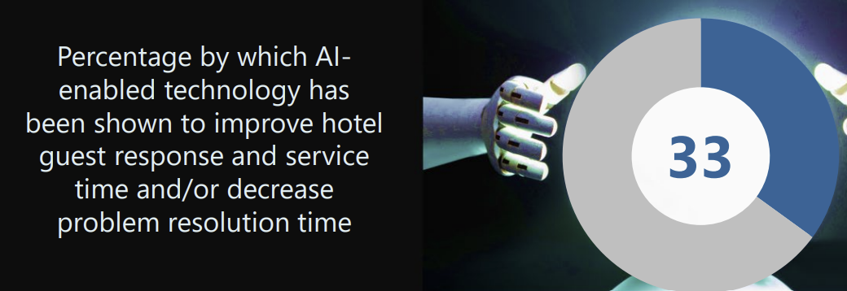
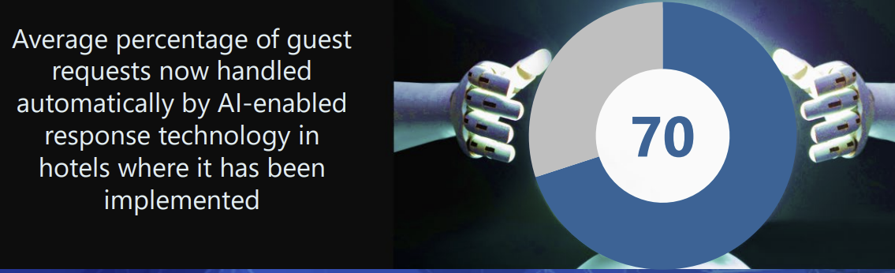
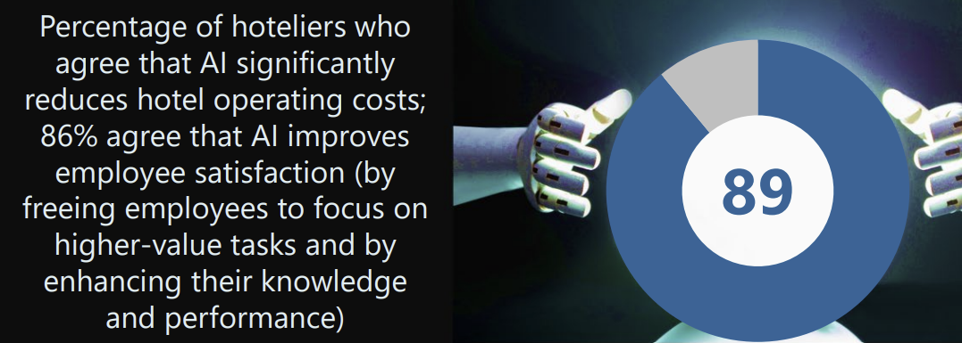
Is This A Good Idea?
User surveys are very positive
Lowers cost on hotel owners
Allows for hotel workers to focus on other aspects of hospitality
Notes:
Throughout the research we performed, the overwhelming amount of evidence pointed to implementing AI into Marriott
The use of such AI helped customers quicker, allowed their problems to be resolved quicker and could tailor smart rooms to the customers liking
Due to the implementation of front facing AI, hotel staff is able to perform tasks that cannot be performed by AI (Cleaning specifics, fixing broken amenities, etc)
Hotel owners spend less on the service the AI provides and can invest that money into improving the customer experience

Slide 7
Which Solutions Fit Best For Hotel Brands?
Brands
Select
Premium
Luxury
Long Stay
All
Multilingual
24/7 AI Customer Support
Automated Check In/Out
Premium/Long Stay
Previous
In Room Service Kiosk/Tablets
Security Through Biometrics
Luxury
Previous
Smart Room Personalization
Notes:
There are 4 Brands Marriott provides: Select, Premium, Luxury, and Longer Stay
Select provides the basic amenities, Premium and Long Stay provide better amenities and service, and Luxury provides the most amenities and services
For our solution we broke the AI Solutions into each brand with higher tiers including all the previous services
All: Multilingual Adaption for Customer Service, 24/7 AI Customer Support, and Automated Check In and Out
Premium/Long Stay: Room Service through Kiosks/Tablets within the room, Security through the customers biometrics(fingerprint, facial recognition, etc)
Luxury: Gets all the previous AI features as well as Smart Room Personnalization to tailor the room to the customers preferences

Slide 8
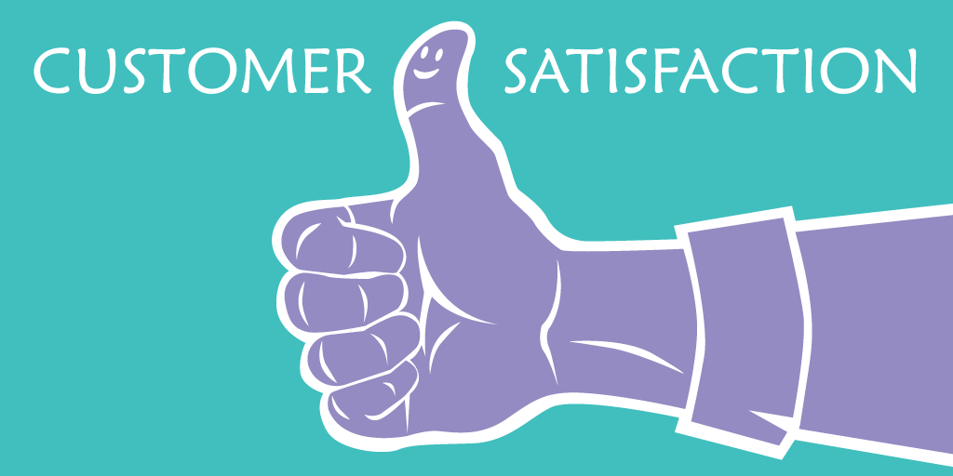
What is The Future of Hotels?
AI has promising use in hospitality
Customers feel catered to
Hotel workers can focus on other customer services
Hotel owners save money, can invest in other services
Notes:
Overall the use of AI in the future of hospitality seems inevitable given all the benefits it provides
The customers will have higher satisfaction due to their needs being catered to
Hotel employees can focus on more complex customer service and tasks that require human intervention
Hotel owners can utilize the money saved by implementing AI to further improve the hotel and it’s amenities

Slide 9
References
https://blog.pressreader.com/hotels/how-artificial-intelligence-is-transforming-the-hotel-industry
https://alfredtechnologies.com/blog/artificial-intelligence-ai-demystified-in-the-hospitality-industry?utm_term=use%20of%20ai%20in%20hospitality&utm_campaign=%5BUSA%5D%20-%20EN%20-%20Search%20-%20Inventory%20-%20KB&utm_source=adwords&utm_medium=ppc&hsa_acc=1311605699&hsa_cam=17934560839&hsa_grp=157552451961&hsa_ad=675201662614&hsa_src=g&hsa_tgt=kwd-2206458698795&hsa_kw=use%20of%20ai%20in%20hospitality&hsa_mt=p&hsa_net=adwords&hsa_ver=3&gclid=CjwKCAjw69moBhBgEiwAUFCx2J25rQZkGzO-dFTUVhl7tZ_H0yUPi_viyle2a_-dj4jbOcd9UQECxRoC5dcQAvD_BwE
https://www.marriott.com/marriott-brands.mi
https://www.deputy.com/blog/the-20-most-common-hotel-guest-complaints
https://masterofcode.com/blog/generative-ai-chatbots-in-the-travel-and-hospitality-industry-use-cases#:~:text=and%20Hospitality%20industry-,Generative%20AI%20Chatbot%20in%20Travel%20and%20Hospitality%20benefits%20for%20companies,leading%20to%20higher%20conversion%20rates.
https://www.cnn.com/videos/business/2023/11/15/self-checkout-revision-shopping-meyersohn-cnnmax-vpx.cnn

